Slide 1
DUTY FREE GIFT, FREE TRAVEL
DUTY FREE GIFT, FRE TRAVEL

Slide 2

A man living in the USA told an interesting incident of his life.
It was an embarrassing situation, but he was proud to tell it because he learnt a great lesson from the incident.
He was traveling to Toronto to see his cousin, who had asked him to bring duty free bottles of alcohol while crossing the border at Niagara Falls.
He purchased three bottles, one more than permitted to be imported duty free.

Slide 3
The immigration officer, along with other routine questions, asked him, “Any alcohol?”
Man replied, “Two bottles of alcohol.”
His son immediately corrected him in loud words to be heard by the officer, “Daddy, not two, but three bottles; a third one is wrapped in the bag and put under the seat.”

Slide 4
One can better understand the embarrassment of the father than it can be described in words.
The officer sent them to the customs office for inspection of the papers and for charging duty on imported goods, where they had to pay duty as well as a fine for not declaring their purchases.

Slide 5
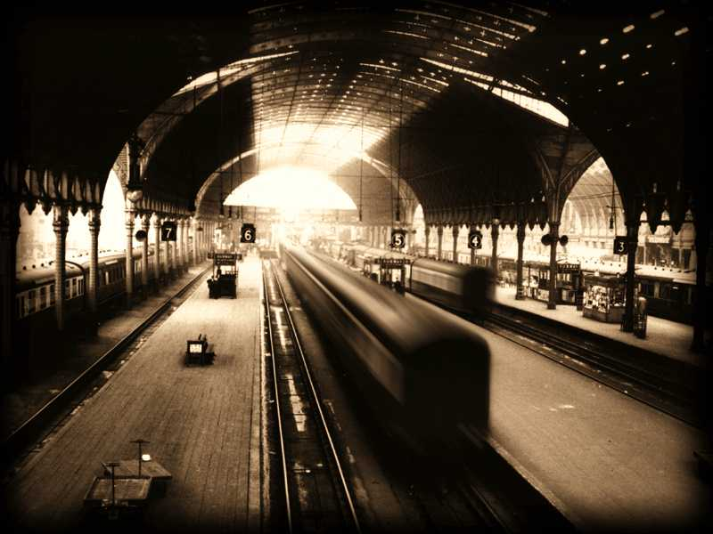
FREE TRAVEL
There was a very similar incident in India, but with a different result.
During summer vacation, a lady, with her two children, went to stay with her parents.
Her father was a big landlord in the Tarai area (U.P.).
He lived in a farmhouse with a lot of open space to play and green fields to walk around.
Every summer, the children spent their vacation at the farm.

Slide 6
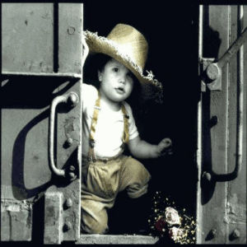
Once, on their return journey, they needed one more child-ticket.
The birthday of the younger child fell during the vacation.
At that age free travel was not permitted to a child, he was required to buy a child-ticket.
The mother thought that it was a matter of only a couple of days, it could be ignored.

Slide 7
When the family disembarked at the Ludhiana railway station, they handed over two tickets to the ticket collector at the gate.
The son, who had been picked up by the mother, told the collector, “My mom had not purchased any ticket for me.
She had picked me up so that you believe me to be a child. My birthday was celebrated last Sunday and now I am not a child, but a boy.”
The educated, well-dressed mother felt very much embarrassed for trying to conceal the age of her son to save a rupee or so.

Slide 8
However, to her relief, the collector smiled.
Giving a used ticket to the boy, he said, “You surely are a grown up boy, here is the ticket for you. You can show it to your friends.”
Addressing the lady, he said, “It is okay, you started your journey when the boy was below age.”

Slide 9

Parents! Watch your children. They are not so naive as you may think. Be careful not to do anything, which lowers your image in their minds.
At the Sikh youth camps, some children told me that they felt let down, and even demoralized when they see their parents drinking and doing other things which they must not do.

